Slide 1
Comp 313
Design and Analysis of Algorithms
Lecture 1 Introduction to Algorithms

Slide 2
Devotional Meditation
Proverbs 1:7
The fear of the LORD is the beginning of knowledge, but fools despise wisdom and instruction.

Slide 3
Lecture Outline
Introduction
Design
Analysis
Applications
Conclusion
Reading materials

Slide 4
Introduction
Algorithm :A finite set of instruction that specifies a sequence of operation to be carried out in order to solve a specific problem or class of problems.
An algorithm can be defined as a well-defined computational procedure that takes some values, or the set of values, as an input and produces some value, or the set of values, as an output. An algorithm is thus a sequence of computational steps that transform the input into output.

Slide 5
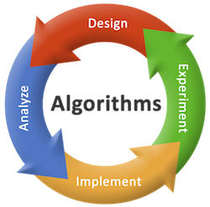
Design , Analysis Implement and Experiment

Slide 6
Definitions Cont…
Analysis of algorithms is the process of finding the computational complexity of algorithms – the amount of time, storage, or other resources needed to execute them. Usually, this involves determining a function that relates the length of an algorithm's input to the number of steps it takes (its time complexity) or the number of storage locations it uses (its space complexity).
Worst-case: f (n) defined by the maximum number of steps taken on any instance of size n.
Best-case: f (n) defined by the minimum number of steps taken on any instance of size n.
Average case: f (n) defined by the average number of steps taken on any instance of size n
Algorithm design refers to a method (Technique) or a mathematical process for problem-solving also known as algorithm engineering eg Divide and Conquer.

Slide 7
Why study Algorithm
1. To understand the basic idea of the problem.
2. To find an approach to solve the problem.
3. To improve the efficiency of existing techniques.
4. To understand the basic principles of designing the algorithms.
5. To compare the performance of the algorithm with respect to other techniques.
6. It is the best method of description without describing the implementation detail.
7. To give a clear description of requirements and goal of the problem to the designer.
8. To understand the flow of the problem.
9. To measure the behavior (or performance) of the methods in all cases (best cases, worst cases, average cases)
10. To identify the resources (memory, input-output) cycles required by the algorithm.
11. To understand the principle of designing.
12. To measure and analyze the complexity (time and space) of the problems concerning input size without implementing and running it; inorder to reduce the cost of design.

Slide 8
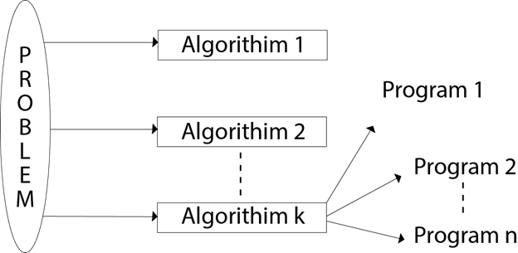
Algorithm vs Program

Slide 9
Algorithm
Input
Output (A1< A2< A3 <A4)
(A1 A2 A3 A4)
Input:
A sequence of n number (a₁, a₂,......a_{n})
Output:
A permutation (reordering) (a'₁, a'₂ .... a'_{n}) of the input sequence such that (a'₁ ≤ a'₂ ≤ ....≤ a'_{n})

Slide 10
Characteristics of a Good algorithm
An algorithm should satisfy the following criteria
Input/output
Correctness
Sequential
Feasibility
Definiteness (Simple and unambiguous)
Finiteness
Effectiveness
Flexibility
Independent

Slide 11
Algorithm example
ALGORITHM: SELECTION SORT (A)
1. k ← length [A]
2. for j ←1 to n-1
3. smallest ← j
4. for I ← j + 1 to k
5. if A [i] < A [ smallest]
6. then smallest ← i
7. SWAP (A [j], A [smallest])

Slide 12
Applications
Chatbots e.g facebook
Computer networks
Stock Market Algorithm
Autopilot algorithm
Facial Recognition Algorithm.
Beauty Pageant Algorithm.
Medical diagnosis
Most program automation require algorithms
Data structures+ Algorithms=Programs(efficient)

Slide 13
Algorithm Design Techniques
Algorithm design is a specific method to create a mathematical process in solving problems. Applied algorithm design is algorithm engineering.
One of the most important aspects of algorithm design is creating an algorithm that is efficient. .

Slide 14
Techniques
Simple recursive algorithms • Backtracking algorithms • Divide and conquer algorithms • Dynamic programming algorithms • Greedy algorithms • Branch and bound algorithms • Brute force algorithms • Randomized algorithms

Slide 15
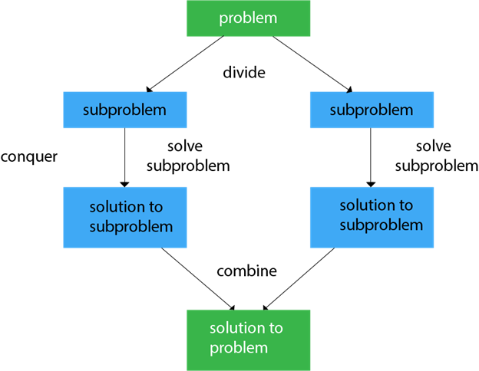
Divide and Conquer

Slide 16
Conclusion / Wrap up
Algorithm design and analysis is programming independent.
This class is 60% theory and 40 % practicals
STAY SAFE, WASH YOUR HANDS

Slide 17
REFERENCE MATERIALS
The design and Analysis of Computer Algorithms by AHO/Hocroft Ullman
Design and analysis of Algorithms by Russell L Shackelford
Introduction to the Design and Analysis of Algorithms by R.C.T Lee, S.S Tseng Chang Y.T Tsai
Judith L GerstingMathematical Structures for computer science 4th edition

